Slide 1
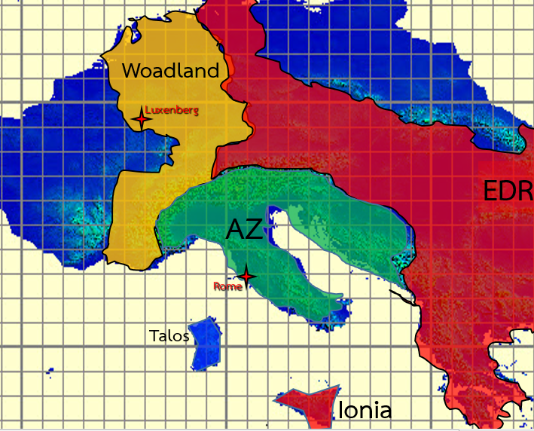

AZ : Air-defense radar site
Eremo del Monte Rua
RADAR station : AN/TPS-79
Šabina Greda
RADAR station : AN/TPS-78
Mobile unit : Giraffe-180/40
Castello di Sorli
RADAR station : AN/TPS-78
Bobotov Kuk
RADAR station : RAT 31DL
Casa Bosco
RADAR station : AN/FPS-117
Mobile unit : Ground Master 400 Alpha (GM400α)
Arco natural
RADAR station : RAT 31DL

